Slide 1
INFO 656-01 Fall 2023 Data, Bias, Communication
Week 2
Amir Imani

Slide 2
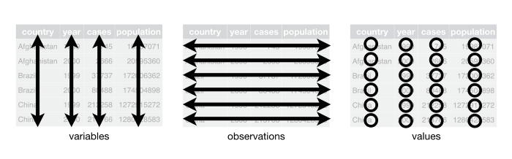
Data
80% of data analysis is spent on the process of cleaning and preparing the data
There is a standard way to organize your data - tidy data
Notes:
Tidy up your data

Slide 3
Data - Group Activity
80% of data analysis is spent on the process of cleaning and preparing the data
There is a standard way to organize your data - tidy data
Notes:
Tidy up your data

Slide 4
activity: Imagine a pair of shoes…

Slide 5
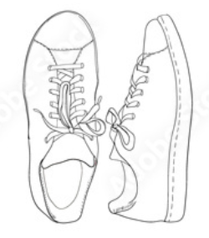
activity: Imagine a pair of shoes…

Slide 6
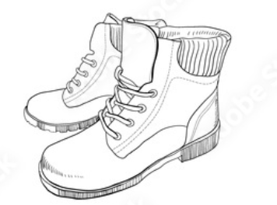
activity: Imagine a pair of shoes…

Slide 7
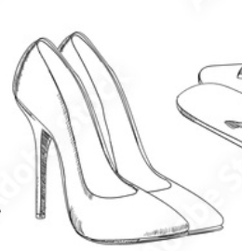
activity: Imagine a pair of shoes…

Slide 8
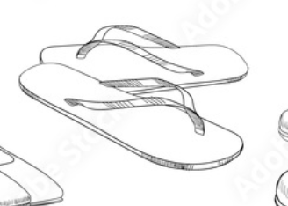
activity: Imagine a pair of shoes…

Slide 9
(Human) Biases
Data:
Reporting bias: subjects choose to reveal certain aspects about themselves or their opinions
Selection bias: those subjects that get into our samples only represent a privileged type of user.
Confirmation bias: only looking for data which may confirm our hypotheses.
Automation bias: refers to the biases which appear when the data we use is only the data we can easily automate.
Architecture of the model
How it's deployed

Slide 10
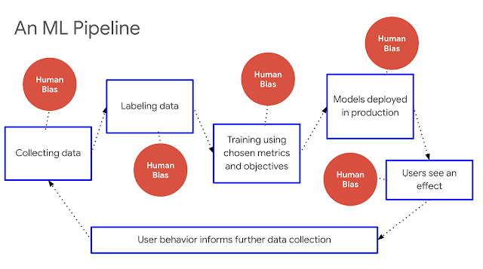
A typical ML pipeline
source: https://ai.googleblog.com/2019/12/fairness-indicators-scalable.html

Slide 11
Fairness - Group Activity
Imagine a planet where Circles and Squares live on
Suppose for some reason we are concerned about discrimination against Squares
Statistical Parity: the fraction of Square that are selected be approximately the same as the fraction of selected Circle applicants.
Notes:
It’s a crude constraint. The rate for both population should be the same. Doesn’t specify how many are granted. It’s a two-sided parity – prevents discrimination against circles.

Slide 12
Fairness Bank
m
n
Application Pool
Notes:
Think about supervised learning – here there is no mention of X
So you can randomly give admission to circles and squares -> what about merit-based? We can accommodate. The fact that this is a bad algo, doesn’t mean there can be a good one that satisfies X and fairness
This is good if you want to start fresh with no prior data

Slide 13
30% default
15% default
m
n
Notes:
There is no mention of Y -> did they default/graduated or not. What if 30% of circles repay, but only 15% of squares
With a perfect predictor, We can pay to 15% of both squares and circles that are paying back -> but what about the 15% circles who didn’t get it? Is it unfair?
Give to 30% of both -> what about the lender? It is loosing money on 15% of squares
It is at odds with optimal decision making -> accuracy
------
One approach is to evenly distribute the mistakes –e make, rather than evenly distributing the loans we give -> rate of false rejections can be the same in both races.
In other word, if not being granted while worthy, is defined as being harmed – a random worthy circle has the same probability of being harmed as a random worth square (false rejection) – so your race is not affecting you in a negative way and if we can improve accuracy of our model, that would be fair – equality of false negative
-----
So lets say our model falsely reject 20% of squares, is it fair as long as it also falsely rejects 20% of circles?
Individually, if you were worthy and didn’t get it, it doesn’t make you feel better to realize another worthy applicant also didn’t get it
Both statistical parity and equality of false negatives offer fairness for groups, but not individuals in those groups.
Lets take a step back, we don’t have perfect data, we don’t have perfect models, and we don’t have perfect fairness definition.

Slide 14
m
n
Notes:
Majority applicants are circle
both populations are equally well prepared for success -> % circles who pay back is equal to % of square who pay back if admitted
Even choosing the most accurate model violates the fairness
If it is complicated for a simple example, how are we handling this for more complex algos?
build separate model for each group? Then we need to explicitly use race as an input for our model
Model card: model details/ intended use/ factors/ metrics/evaluation data/ training data/ quantitative analysis/ ethical considerations/ caveats & recs

Slide 15
Few Fairness Metrics
Bias Metric | Description | Example Question
Difference in Positive Proportions in Predicted Label (DPPL) | Measures the difference in the proportion of positive predictions between the favored facet a and the disfavored facet d. | Has there been an imbalance across demographic groups in the predicted positive outcomes that might indicate bias?
Disparate Impact | Measures the ratio of proportions of the predicted labels for the favored facet a and the disfavored facet d. | Has there been an imbalance across demographic groups in the predicted positive outcomes that might indicate bias?
Difference in Conditional Acceptance (DCAcc) | Compares the observed labels to the labels predicted by a model and assesses whether this is the same across facets for predicted positive outcomes (acceptances). | Are there more or less acceptances for loan applications than predicted for one age group as compared to another based on qualifications?
Accuracy Difference (AD) | Measures the difference between the prediction accuracy for the favored and disfavored facets. | Does the model predict labels as accurately for applications across all demographic groups?
Counterfactual Fliptest (FT) | Examines each member of facet d and assesses whether similar members of facet ahave different model predictions. | Are a group of a specific age demographic, matched closely on all features with a another age group, paid on average more than that other age group?"

Slide 16
Questions?

